Slide 1



Data Analysis with Python
CBCA 223

Slide 2


Module 1
Purpose of data analysis, Structured and Unstructured data, Steps of data analysis, Python Packages for Data Analysis: Numpy, Scipy, Matplotlib, Plotyly, NLTK. Data Frames, Usage of frames analytical roles, File handling and reading data for processing, Pre-processing data using multiple python frameworks, Data Formatting, Data Manipulation, Data normalization, Data Merging, Data reshaping, Data Wrangling, Aggregation functions.

Slide 3
Purpose of data analysis
There are three term variable, measurement and data.
Variable is a characteristic of any entity being studied that is capable of taking on different values.
-X is a variable it can take any values 1 or 2 or any
Measurement is, a standard processes used to assign numbers to particular attributes or characteristics of variable are called a measurement.
For variable X, we want to substitute some values. For that value, you have to measure the characteristics of the variable, that is nothing but your measurement.
Data are recorded measurement.
Notes:
So there is a variable you measure the phenomena, after measuring the phenomena you are substituting some value for the variable so the variable will take a particular value that value is nothing but your data. So X is the variable for example number 5 is the data. How you are measuring that 5, that is called measurement. Then what is generating so much of data

Slide 4
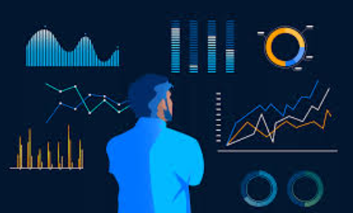
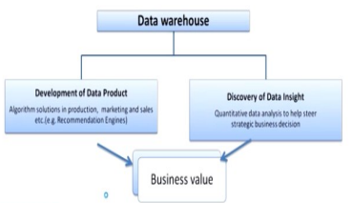
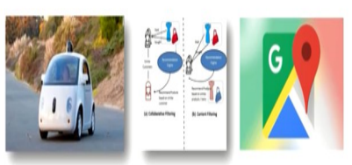
what is generating so much data
Data can be generated different way humans, machines, and human - machines combines.
How data add value to Business
Notes:
The humans, machines and human - machines combines in the sense, now seen everybody is
having the various Facebook account, we have LinkedIn account, we are in various social
network sites. Now the availability of the data is not the problem. It can be generated
anywhere where the information is generated and stored and structured or unstructured
format.

Slide 5
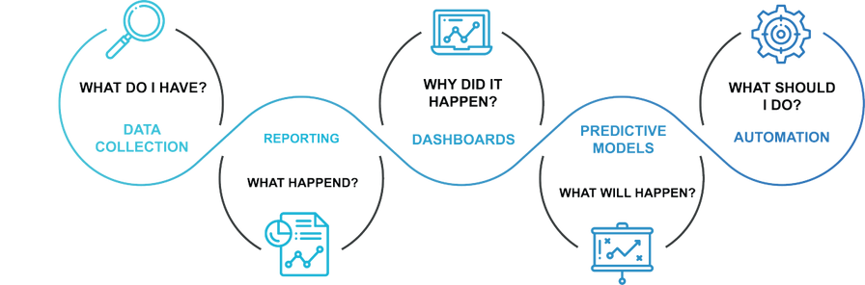
why data is important?
Data
helps in making better decisions,
helps to evaluate the performance.
helps in improving the performance.
helps to understand the consumers and the markets,
Notes:
The data helps in making better decisions, data helps in solve
problem by finding the reason for underperformance. Suppose some company it is not
performing properly by collecting the data we can identify what was the reason for this under
performance. The data helps one to evaluate the performance. So what is the current
performance, the data also can be used for benchmarking the performance of your business
organization.
And after benchmarking data helps one improving the performance also, so data also can help
one understand the consumers and the markets, especially the marketing context. You can
understand who are the right consumers and what kind of preferences they are having in the
market.

Slide 6
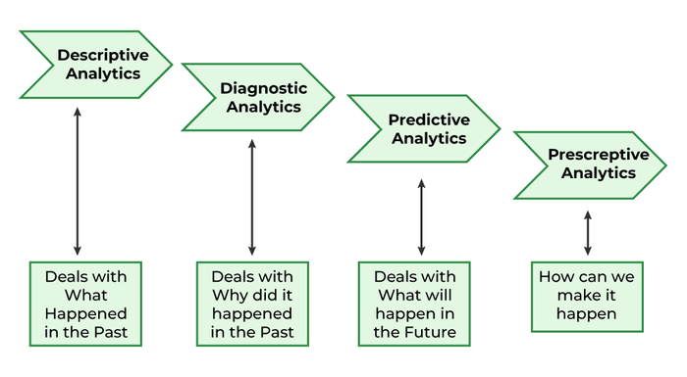
Data analytics and its types
data analytics is the scientific process of transforming data into insights for making better decisions.
Prof. James Evans, defined the data analytics as the use of the data, information technology, statistical analysis, quantitative methods and mathematical or computer-based models to help managers gain improved insight about
their business operations and make better, fact-based decisions.
Is the process of examining, transforming and arranging raw
data in a specific way to generate useful information from it. So data analysis allows for the
evaluation of data through analytical and logical reasoning to lead to some sort of outcome or
conclusion in some context. Data analysis is a multi-faceted process that involves a number
of steps approaches and diverse techniques.
Notes:
data analytics is the scientific process of transforming data into insights for making better decisions. See it is a scientific process for transforming the data into for making better decisions, even without the data also even without doing analytics also you can make the decision but you cannot make the better decision without analytics. By the virtue of your experience on intuitions you can take the decisions that also sometimes may be correct. The opportunity abounds for the use of analytics and big data
such as: for determining the credit risk, for developing new medicines, especially in
healthcare. The healthcare analytics is an emerging, that is helping you to identify what is the
correct medicines. Finding more efficient ways to deliver product and services. For example:
in the banking context data analytics is used for preventing the fraud, and it is uncovering the
cyber threats.

Slide 7
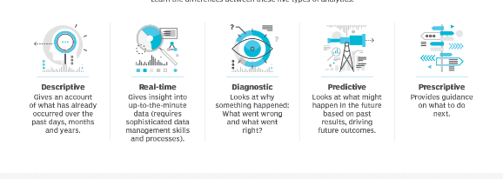
Types of Data Analytics
Descriptive analytics
Diagnostic analytics
Predictive analytics
Prescriptive analytics
Real-time analytics
Sentiment analysis
70%
@reallygreatsite

Slide 8
Use case of data analytics in the hospitality industry
Descriptive analytics
Diagnostic analytics
Predictive analytics
Prescriptive analytics
Real-time analytics
Sentiment analysis
@reallygreatsite

Slide 9
1. Descriptive analytics
most basic form of data analytics.
It involves analyzing historical data to understand what has happened in the past.
For instance, descriptive analytics can tell you how many patients stayed in hotel or hospital last month, the average duration of stay, or the most popular menu item in your restaurant.

Slide 10
2. Diagnostic analytics
This type of analytics is used to understand why something happened. By analyzing detailed datasets, you can find patterns and correlations that explain past events.
For example, if there was a sudden drop in your hotel bookings, diagnostic analytics might reveal that it was due to negative online reviews or a local event that impacted travel.

Slide 11
. Predictive analytics
Predictive analytics uses statistical techniques and machine learning algorithms to analyze historical data and predict future events. In the hospitality industry, this can be used to forecast demand, allowing for optimized pricing and better resource allocation.
For example, predictive analytics can tell you when the peak periods for your hotel will be, allowing you to adjust prices and staffing levels accordingly.

Slide 12
4. Prescriptive analytics
This is the most advanced form of analytics, providing recommendations on the best course of action to achieve a particular objective. It takes into account various scenarios and possibilities, leveraging optimization and simulation algorithms.
In a hotel scenario, prescriptive analytics might recommend specific marketing strategies to target a new customer segment or suggest changes in room pricing to maximize revenue.

Slide 13
5. Real-time analytics
This type of analytics involves analyzing data as soon as it comes into the system, allowing businesses to respond quickly to changing situations.
For instance, real-time analytics can be used in a hotel to alert staff when a room is ready for cleaning, based on data from keycard use.

Slide 14
6. Sentiment analysis
This is a form of data analytics that focuses on understanding emotions and opinions expressed in online reviews and social media posts.
This can provide valuable insights into how guests perceive your hospitality business, and where improvements may be needed.

Slide 15
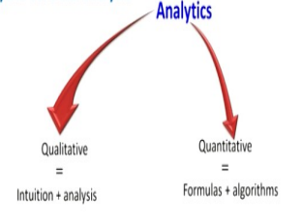
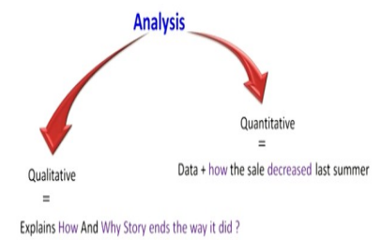
Data analysis vs Data analytics.
Data analytics is studying about what will happen in future and with the
help of analytics. We can predict explore possible potential future events.
Data Analysis Is the process of examining, transforming and arranging raw data in a specific way to generate useful information from it.
Data analysis allows for the evaluation of data through analytical and logical reasoning to lead to some sort of outcome or conclusion in some context.

Slide 16
Structured Data
Structured data –
Structured data is data whose elements are addressable for effective analysis.
organized into a formatted repository that is typically a database.
It concerns all data which can be stored in database SQL in a table with rows and columns.
They have relational keys and can easily be mapped into pre-designed fields.
@reallygreatsite

Slide 17
Semi Structured & UnStructured Data
Semi-Structured data – formation that does not reside in a relational database but that has some organizational properties that make it easier to analyze. With some processes, you can store them in the relation database (it could be very hard for some kind of semi-structured data), but Semi-structured exist to ease space. Example: XML data.
Unstructured data – is a data which is not organized in a predefined manner or does not have a predefined data model,
it is not a good fit for a mainstream relational database. So for Unstructured data, there are alternative platforms for storing and managing, it is increasingly prevalent in IT systems and is used by organizations in a variety of business intelligence and analytics applications. Example: Word, PDF, Text, Media logs.

Slide 18
Properties | Structured data | Semi-structured data | Unstructured data
Technology | It is based on Relational database table | It is based on XML/RDF(Resource Description Framework). | It is based on character and binary data
Transaction management | Matured transaction and various concurrency techniques | Transaction is adapted from DBMS not matured | No transaction management and no concurrency
Version management | Versioning over tuples,row,tables | Versioning over tuples or graph is possible | Versioned as a whole
Flexibility | It is schema dependent and less flexible | It is more flexible than structured data but less flexible than unstructured data | It is more flexible and there is absence of schema
Scalability | It is very difficult to scale DB schema | It’s scaling is simpler than structured data | It is more scalable.
Robustness | Very robust | New technology, not very spread | —
Query performance | Structured query allow complex joining | Queries over anonymous nodes are possible | Only textual queries are possible

Slide 19
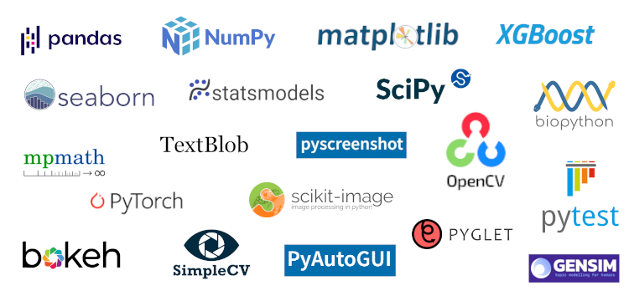
Python Libraries

